Slide 1

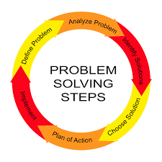
Enhancing Private Label Buying

Slide 2

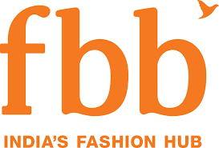

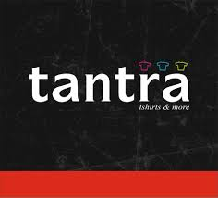
Problem Statement
Your client ABC is a leading retail apparel store in India, ABC offers 3 types of loyalty cards to its customers ( Gold, Silver & Bronze).
ABC wants its card holding customers to spend more on its private label products due to higher margins available in private labels.
ABC has hired you to help them to achieve this objective, What recommendation would you give to ABC?

Slide 3
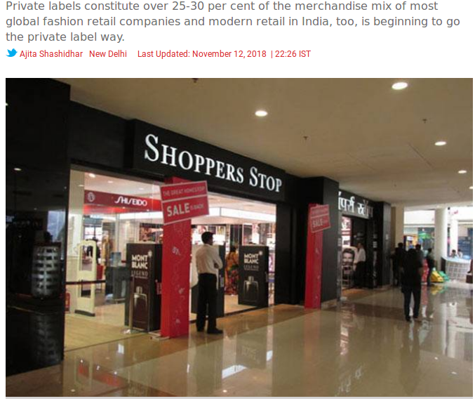
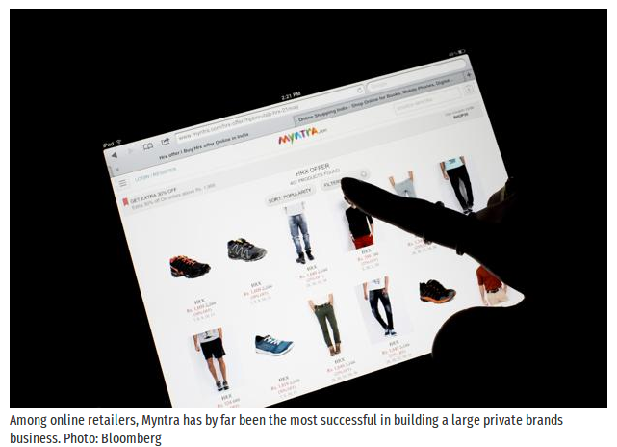
Trends on Private Label in Market

Slide 4
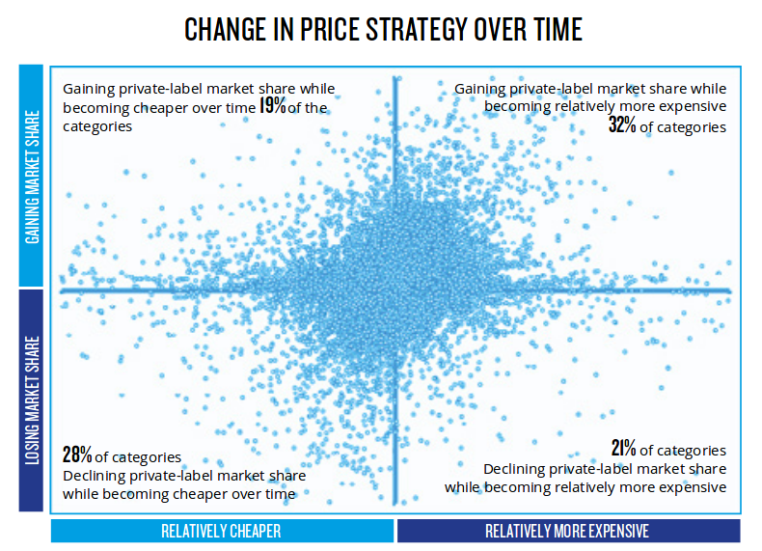
Affect of Private Labels in Market
The organized retail sector has immense scope for growth in India. The Apparel sector has seen organized retail market penetration of close to 24% with a predicted increase to 31% by 2021.
While private label apparel had a negative connotation in the minds of customers, as being inferior or of low quality, that mindset is changing as they find little difference in quality between a manufacturer label product and a private label product.
The share of Private labels in the organized retail sector stood at 12-20% in 2016 for brick and mortar, and 10-15% for e-commerce players. This number is going upwards.

Slide 5
Target products and customer groups for Private Labels
Spending on Apparel constitutes around 4% of household expenditure in India and there is rise of purchasing trends in middle class which will create opportunity to retail to the masses
Women wear is expected to become the dominant sector by value sales in the nearfuture. Both Kidswear and Women’s wear are expected to grow fast. While Men’s Wear is expected to be the slowest moving category
Segments like Trousers/Skirts, Woven tops, Active Sports Wear represent good opportunities for growth
In the recent years, several International brands have entered the Indian retail industry,looking to target the growing expenditure by the Young Indian shopper.We have to do the same by keeping the target on young indian shopper
Consumers in the age group of 15-34 years, represents around 35% of the total Indian population & 300 million youth would enter the labour force by 2025 , this consumer group tends to more geared towards the consumerism trend

Slide 6
Growth Driver of Private Labels
Retailers profit increase about 10% more on private brand and products .
Customers recognize the value of private label products and are unwilling to pay premium prices
For national wide brands .
Independent pricing strategy.
Better margin and better control on deliveries.
They imitate the designer brand which reduces the R&D expenses.

Slide 7
Why Target Customers should have a loyalty card
Boosts Your Reputation & Goodwill
Influenced by savings and rewards
Once It Gets Started, It becomes self sustaining machine
Purchase behavior can be tracked
Higher spending than other customers

Slide 8
Problem Statement Worksheet
How can ABC increase it’s share of private label sales among the loyalty card holding customers from X% to Y% in the next 1 year?
1. Background
4. Constraints
ABC has a three tier loyalty program for its customers – Gold, Silver and Bronze based on the value of purchases they make.
Data for non loyalty card holding customers is not available
Manufacturer labels cannot be phased out completely
2. Desired outcome
5. Stakeholders
Increase in share of private label sales from X% to Y%
Marketing Team for Retailer ABC
Supply Team for Retailer ABC
3. Scope
6. Resources
Offline & online sales
Customers holding loyalty cards
POS Data
Loyalty cardholders database
Notes:
8

Slide 9
Issue tree
1.11
Increased share of in-store display
1.1
C1
Improve brand awareness/ perception/ visibility
1.12
Promotions
C2
1.21
Privilege sales
How can ABC increase it’s share of private label sales among the loyalty card holding customers from X% to Y% in the next 1 year?
1
1.2
Better incentives on purchase of private labels
1.22
Faster membership upgradation
C3
1.23
Customized offers to loyalty card holders
C4
1.31
Regular sales/discounts & online sales
1.3
Push private labels
1.32
Increase production of manufacturer label alternatives
C5
Notes:
9

Slide 10
Issue tree
More shop floor displays dedicated to private labels
Purchase behavior analyzed and combined with shopper details to create an exhaustive database
C1
C4
Increased share of in-store display
Customized offerings to loyalty card holders
Increased shelf space dedicated for private labels
Increasing the material quality of products like using good fabrics for garments
Based on demographics alone, buckets of offers can be created on constraints like age group etc
Breaking the perception of low price-low quality
Manufacture more quantities of high demand apparel category for the private label and making it easily visible in outlets.
C2
C5
Promotions
Develop a pricing policy and include warranty and gaurantee policies
Increase Production
Celebrity/Country of origin connect to communicate premium quality via ads on electronic and social media
Ensure availability of private label alternatives for manufacturer label products and using supply chain management strategies.
Offer higher points/ purchase on select private labels
C3
Give reedem points on higher purchases like on buying 25k goods give 5k reedem points
Faster Upgradation of membership
Target Bronze and Silver tier loyalty card members and approaching the non card holders.
Notes:
10

Slide 11
Potential Solutions
Short Term Solutions (0 - 3 months):
Arranging a Limited-Time Sales event or end season sales .
Bundle Your Products and Services like buy1 get1 free offers or discounts.
Medium Term Solutions (3 - 6 months):
Tie up with local or budding designers and experimenting with new styles R&D with them.
Trainings for staff at outlet shops and electronic advertisement of new products & using social media presence for brand building .
Tying up with credit card vendors to make a combo loyalty card + credit card system.
Long Term Solutions (6 - 12 months):
Embedding tech in sales by using recommendation system, customer behaviourial analysis, sales forecasting etc.
Online sales of products by making own ecommerce site and also tying up with well established brand like amazon, flipkart and also starting exclusive brand outlets which helps brands create exclusive brand identities
Taking customer reviews and using it for promotion usage and brand building .

Slide 12
References
https://www.livemint.com/Companies/BJ5mBDA3xhhwjnhQpGqcyO/Myntra-makes-big-bets-with-private-labels.html
https://www.sourcify.com/10-popular-private-label-trends-2018/
https://retail.economictimes.indiatimes.com/news/e-commerce/e-tailing/indias-e-commerce-wars-to-be-reshaped-by-private-label-brands/64381160
https://www.indiaretailing.com/2018/07/30/fashion/private-labels-a-changing-perspective-in-indian-retail/

